Slide 1
Project summary

Slide 2
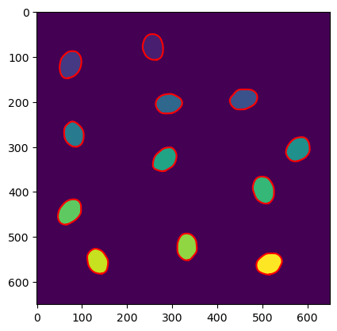
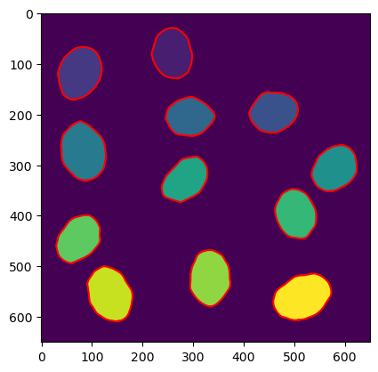
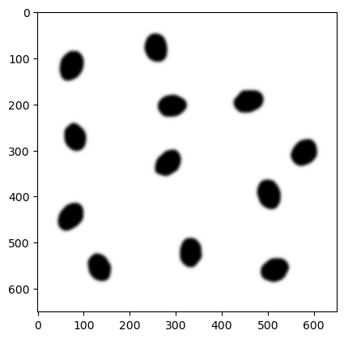
- gaussian filter, - histogram visualization - treshold choose - watersheld -different values for each cel – thats how we can differentiate tchem - regionprops function – to calculate amount of cells/nuclei, masks to calculate cell/nuclei size (sum of pixels with given value), intensity – mask + oryginal channel green → mean value of pixels in given cell

Slide 3
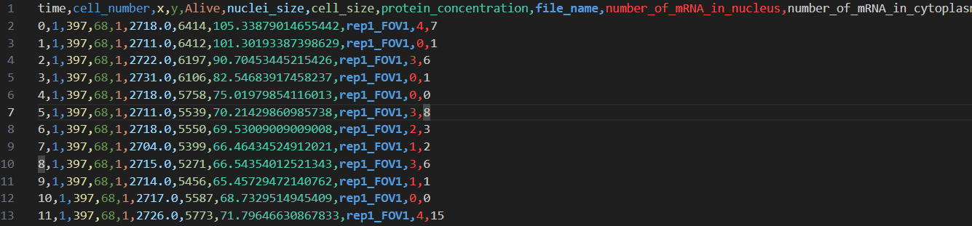
Our table with data

Slide 4
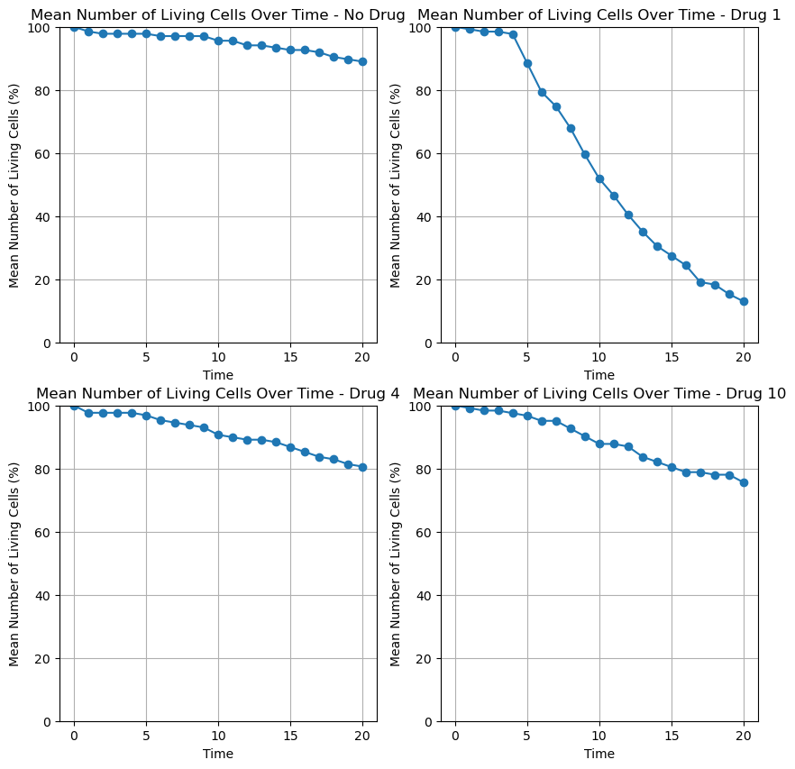

Slide 5
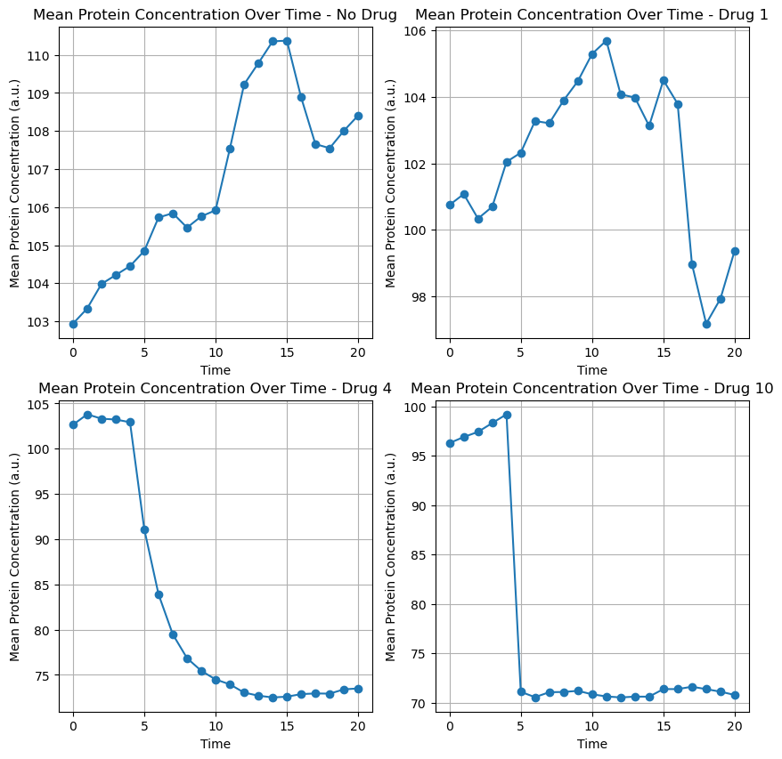

Slide 6
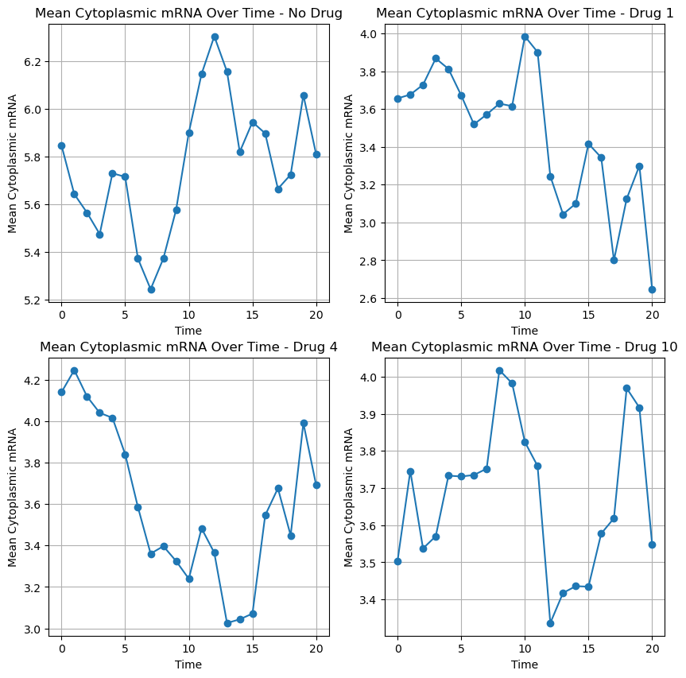

Slide 7
